Slide 1
Mod C.5 Artificial Intelligence – June 03
Agenda
Mod C.5 Artificial Intelligence
Level 1 & 2 –Due Last Week
Level 3 – AI Job Articles - Today
Level 4 – AI Job SOPs - Tomorrow
Upcoming
Tomorrow: Finish Mod C.5

Slide 2

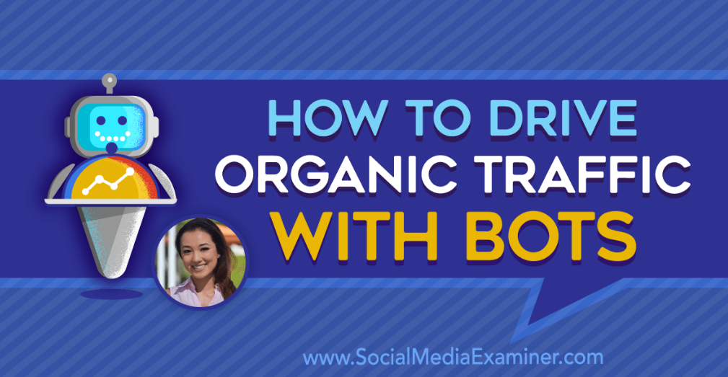
Level 3 – AI Article Reviews
Social Media Bots

Slide 3
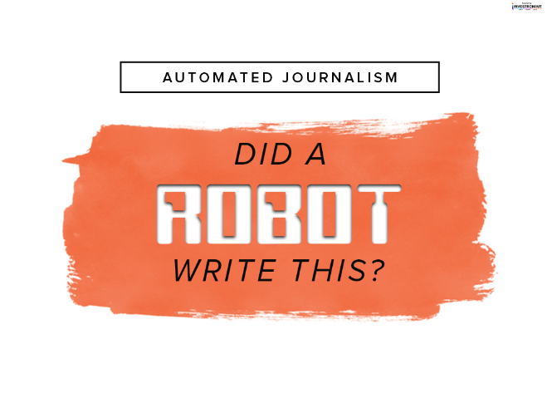
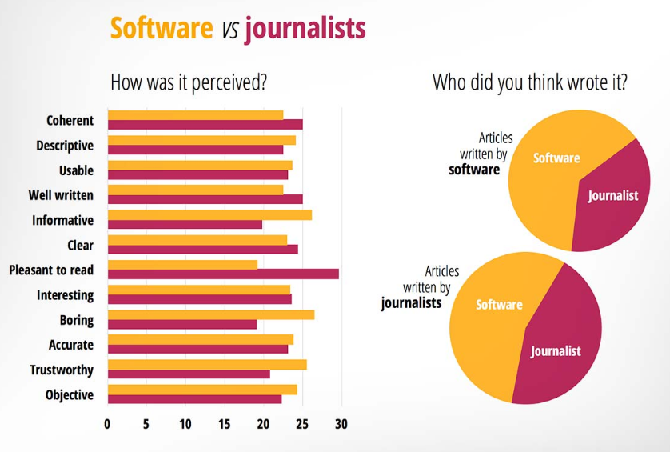
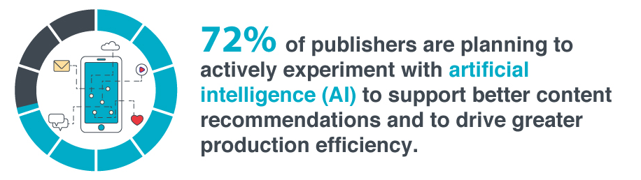
Level 3 – AI Article Reviews
Automated Journalism

Slide 4
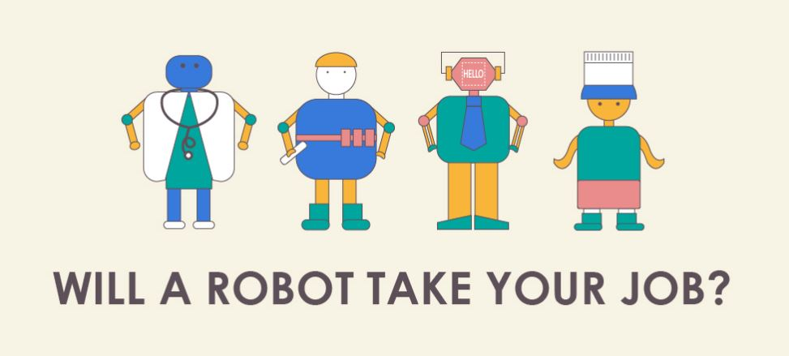
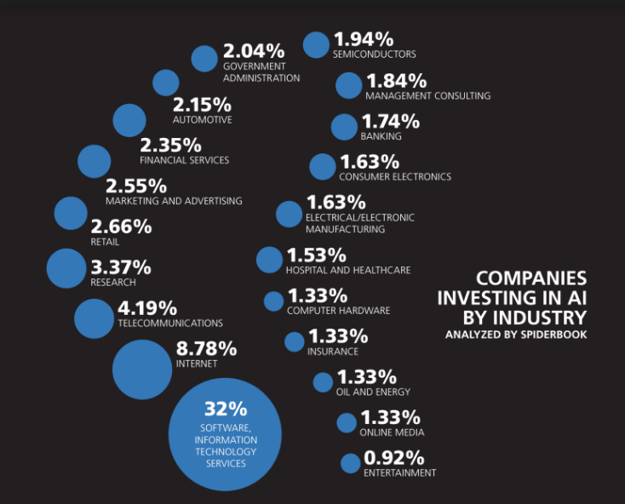
Level 4 Job SOPs
Will AI Take My Job?
Prep for Course Summative
But is it just robots?

